Slide 1
Capstone Project
Retail Sales Prediction
Individual project-
Name-Harshad Savle
Email-harshad.savle@gmail.com

Slide 2
Contents
Problem Statements
Understanding Dataset
Data Pre-Processing
Exploratory Data Analysis
6. Feature Engineering
ML Model
Feature Importance
Challenges faced
Conclusions

Slide 3
Problem Statements
Rossmann operates over 3,000 drug stores in 7 European countries. Currently, Rossmann store managers are tasked with predicting their daily sales for up to six weeks in advance. Store sales are influenced by many
factors, including promotions, competition, school and state holidays, seasonality, and locality. With thousands of individual managers predicting sales based on their unique circumstances, the accuracy of results can be quite varied.
You are provided with historical sales data for 1,115 Rossmann stores. The task is to forecast the "Sales" column for the test set. Note that some stores in the dataset were temporarily closed for refurbishment.

Slide 4

Understanding The Dataset
Data Description
Rossmann Stores Data.csv - historical data including Sales
store.csv - supplemental information about the stores
{After merging both the datasets we have 1017209 number of records and 18 number of fields and our
dataset period is from 1st Jan-2013 to 31st July-2015.}
Data Fields
Most of the fields are self-explanatory. The following are descriptions
for those that aren't.
Id - an Id that represents a (Store, Date) duple within the test set
Store - a unique Id for each store
Sales - the turnover for any given day (this is what we are predicting)

Slide 5
Customers - the number of customers on a given day.
Open - an indicator for whether the store was open: 0 = closed, 1 = open.
StateHoliday - indicates a state holiday. Normally all stores, with few exceptions, are closed.
on state holidays. Note that all schools are closed on public holidays and weekends. a = public holiday, b = Easter holiday, c = Christmas, 0 = None
SchoolHoliday - indicates if the (Store, Date) was affected by the closure of public schools
StoreType - differentiates between 4 different store models: a, b, c, d.
Assortment - describes an assortment level: a = basic, b = extra, c = extended
CompetitionDistance - distance in meters to the nearest competitor store.
CompetitionOpenSince[Month/Year] - gives the approximate year and month of the time the nearest competitor was opened

Slide 6

Promo - indicates whether a store is running a promo on that day
Promo2 - Promo2 is a continuing and consecutive promotion for some stores:
0 = store is not participating, 1 = store is participating.
Promo2Since[Year/Week] - describes the year and calendar week when the store started participating in Promo2
Promo Interval - describes the consecutive intervals Promo2 is started, naming the months the promotion is started anew. E.g. "Feb,May,Aug,Nov" means each round starts in February, May, August, November of any given year for that store

Slide 7

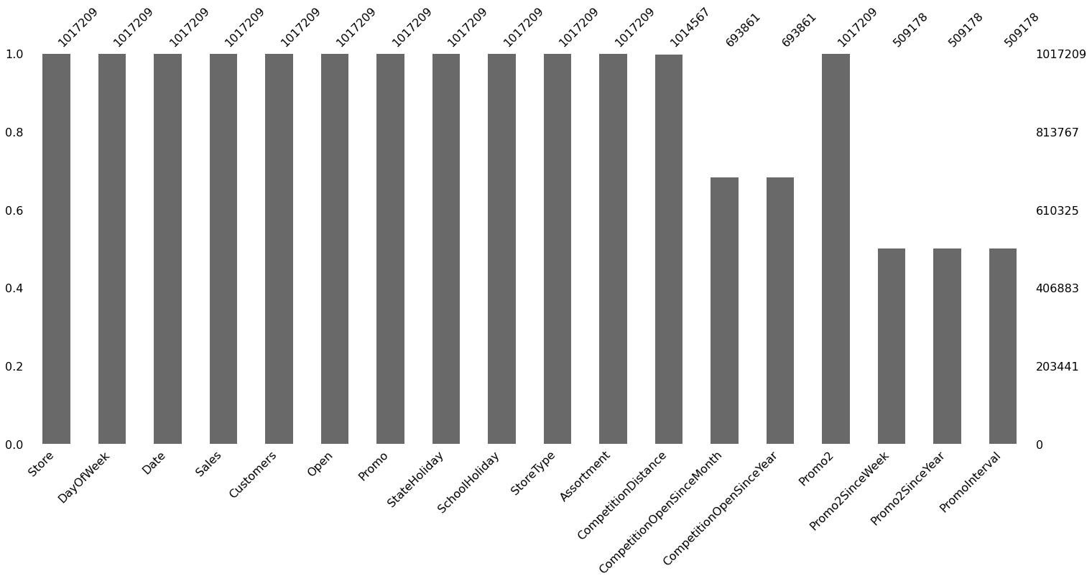
Data Pre- Processing
As We have a Dataset of Rossmann Stores which contain 1017209 rows and 18 colums.
Some columns have missing values.

Slide 8

Data Pre- Processing
Data wrangling and processing requires cleaning of data and preparing it for further
analysis. Our cleaning process involved the following parts:
Merge Both Dataset: We have merge both the available dataset
Null Value Treatment:
After checking distribution of ‘CompetitionDistance’ column we find out that data is left skewed so we use median to replace null values.
And we replace the null values present in column ‘CompetitionOpenSinceMonth’,
‘CompetitionOpenSinceYear’ with mode.
We have dropped columns where null values present in ‘Promo2SinceWeek’, ‘Promo2SinceYear’, ‘PromoInterval’ because columns having more number of null values and these columns are not much impactful.

Slide 9
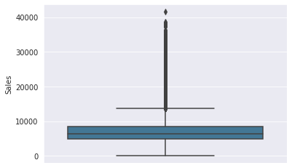
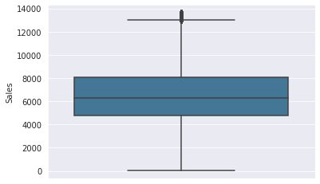
Handling Outliers in Target Variable
Started with our target variable as it is the most important variable.
This Data set have some genuine values which seems as outliers. so we had worked on only those values which are very important to remove and removal of those will does not affect our data set.

Slide 10

Exploratory Data Analysis
Basically we have two important categorical columns which need explanation in our dataset so lets start our visualization with those data.
a = Basic
b = Extra
c = Extended
a = Public Holiday
b = Easter Holiday
c = Christmas Holiday
d = None
State
Holidays
Assortment

Slide 11


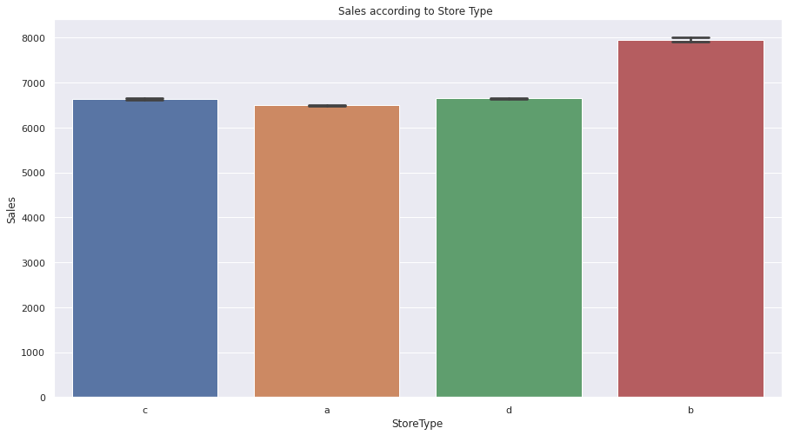
Store Models
This plot shows relation between Store Type and Sales.
In the above chart The sales in the store type "b" have higher sales as compare to other store category. the rest of store having almost same sales.
If you want more sales then go with "b" Store Type.

Slide 12

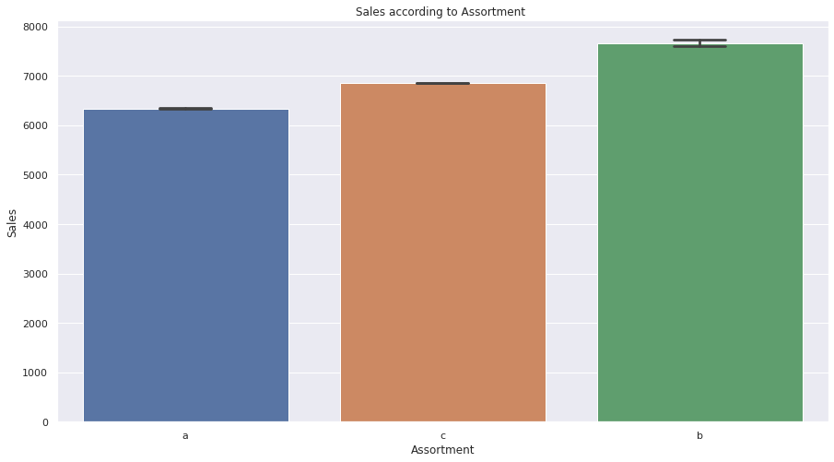
Assortment Levels
0 = Basic, 1 = Extra, 2 = Extended
The sales in which product assortment type 1 have higher sales as compare to other assortment category. the rest of assortment having almost same sales.

Slide 13

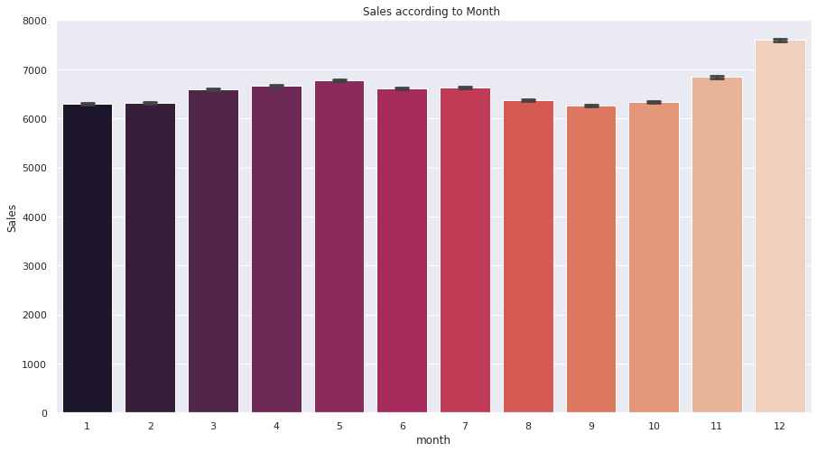
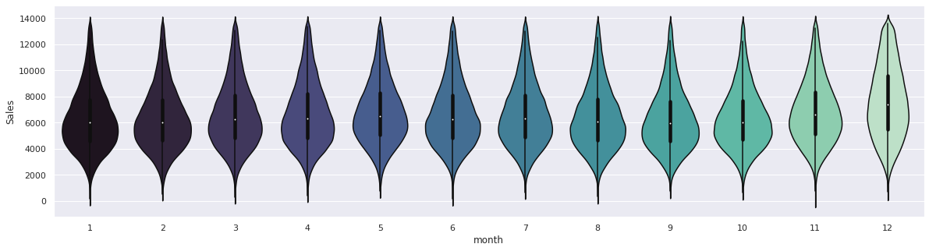
Sales in each Month
According to the plot we can see that the sale is increases in the December and Decreases in January and we can conclude that stores need more supply in between July to December stores should offer some discount in january to June to attract more customers.

Slide 14

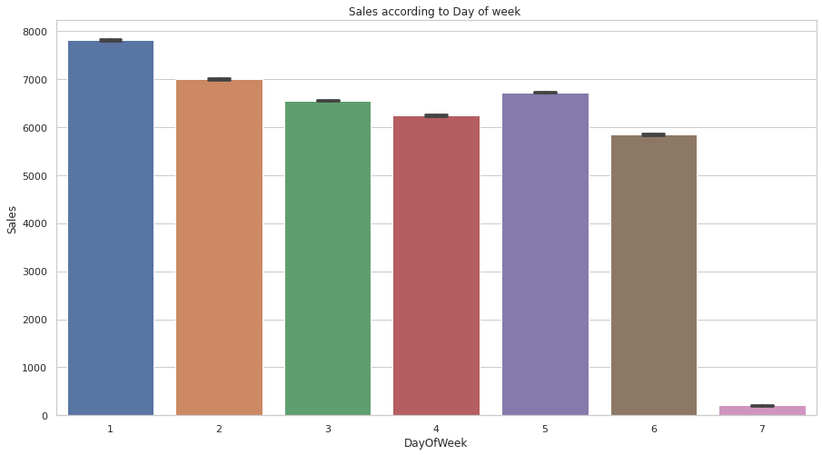
Days of week with Sales
We are plotting Bar graph to see the Sales according to Days in week.
We can conclude that sales are high on
Monday and low on Sunday.
It may be because of holiday Stores have to try increasing sale on sunday or they can close the store for half day on sunday to minimize expenditure.

Slide 15
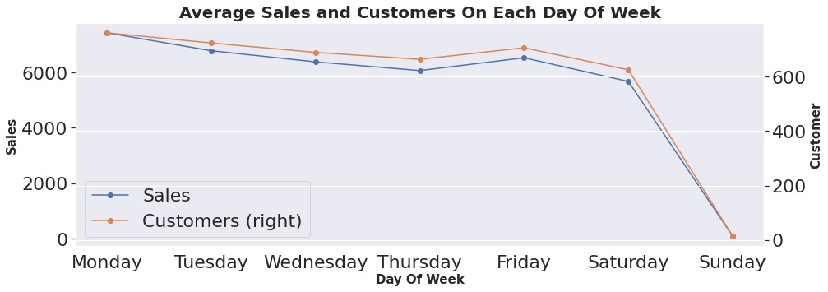
Average Sales And Customers On Each Day Of Week
Sales and customers are at maximum on Mondays while sales and customers are nearly zero on Sundays because it seems like store use to remain closed on Sundays.

Slide 16
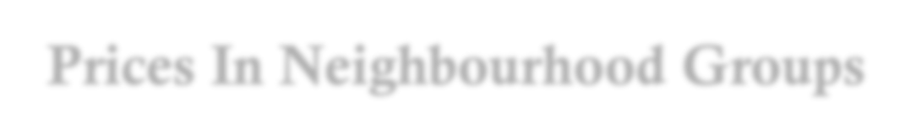
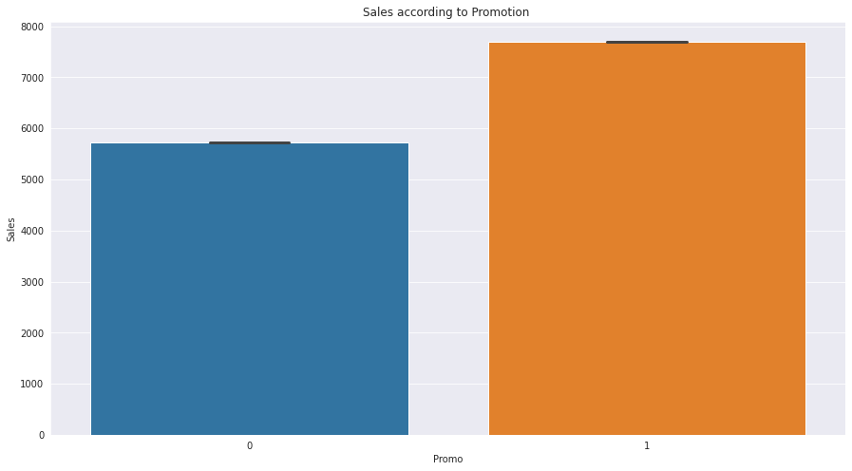
Prices In Neighbourhood Groups
As we can see that the store who participating in promotion having more sales as compare to other. which means promotion is the key to attract the customer towards the store.

Slide 17
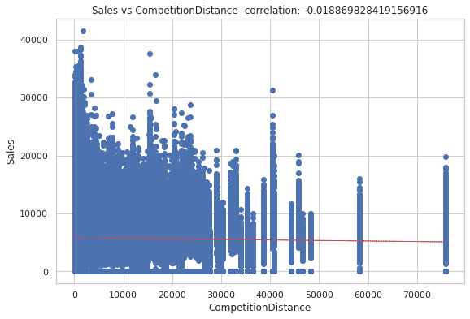
Effect Of Competition Distance on Sales
Mostly stores were not that far from competitors and the stores were densely located near each other and surprisingly sales were higher when competition was nearer.

Slide 18
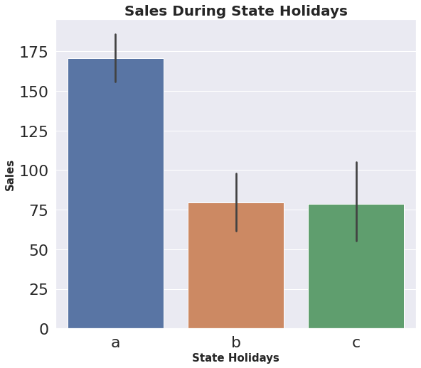
Sales During State Holidays
a = Public holiday, b = Easter holiday, c = Christmas
Stores has made more sales during Public holidays compared to Easter and Christmas holidays.

Slide 19
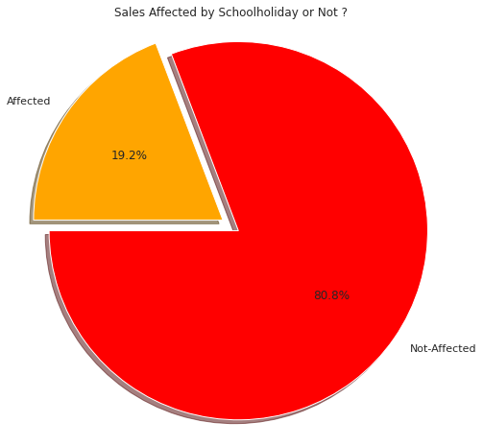
Impact Of School Holidays On Sales
19.20% of the total sales gets affected by the school holidays which also means that around 20% of the sales are oriented from the school students.

Slide 20

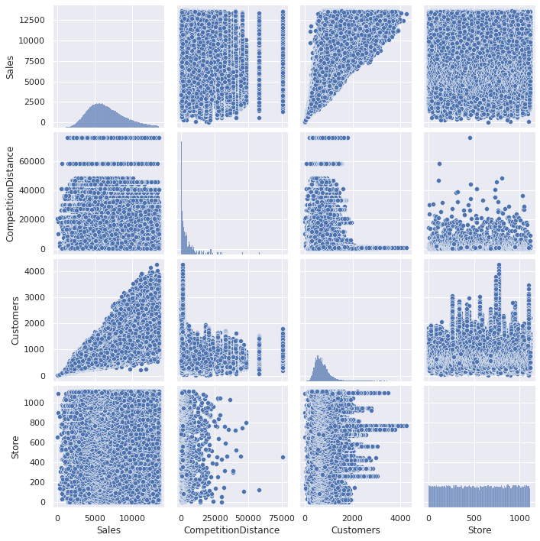
Linearity with Pair Plot
Linear regression needs the relationship between the independent and dependent variables to be linear. So we used pair plot to check the relation of independent variables with the Sales variable.
And we conclude that features like ‘Customers’, ‘CompetitionDistance’ and ‘Stores’ have a positive Relation.

Slide 21
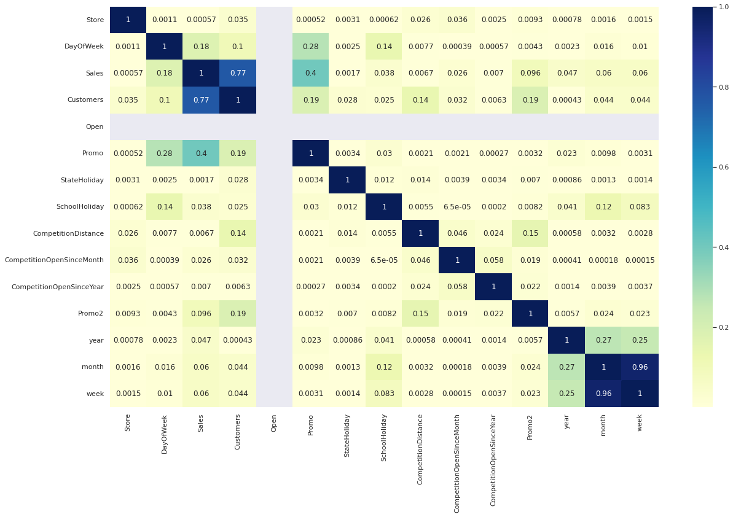
Multicollinearity: We didn't find any correlation between independent variables but we found
some correlation with our dependent feature which is a good sign for our model. This plot shows that customer is highly co-related with sales.

Slide 22
Features Transformation
For column State Holiday we convert variable a, b, c into numerical variable 1 and existing variable 0 is kept as it is hence we got numerical feature having variables 0 and 1. It makes easy for computation in machine learning model.
And we convert State Holiday column into integer Data type.
Data Extraction: We have extracted Date, Year, Month from Date column for further analysis and then dropped the Date column.

Slide 23

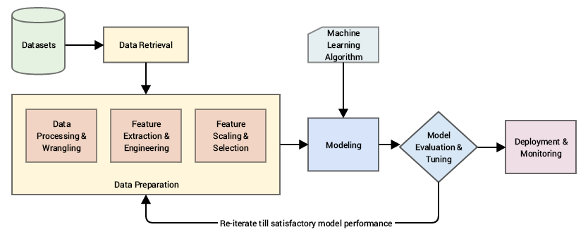
ML Model
After performing all these steps our dataset is ready for ML Modeling. Now we will train a model over a set of data, providing it an algorithm that it can use to reason over and learn from those data and then making predictions on those data which hasn’t been seen.

Slide 24
ML Model Performance
Looking at the various regression techniques we found out that ‘Random Forest’ have better
model performance (Adjusted R2 : 0.9639) compared to other regression models.
Regression Techniques | MAE | MSE | RMSE | R2 | Adjusted R2
Linear | 866.335 | 1286832.8297 | 1134.3865 | 0.7797 | 0.7797
Lasso | 866.2747 | 1286827.3908 | 1134.3841 | 0.7797 | 0.7797
Ridge | 866.2762 | 1286826.1299 | 1134.3835 | 0.7797 | 0.7797
Elastic net Regress | 874.1013 | 1331170.6124 | 1153.76 | 0.7721 | 0.7721
Decision Tree | 445.8559 | 407405.8122 | 638.2834 | 0.9302 | 0.9302
Gradient Boosting | 717.1779 | 871463.1338 | 933.5218 | 0.8508 | 0.8508
XGBoosting Regression | 471.7540 | 393631.5969 | 627.4006 | 0.9326 | 0.9326
Random Forest | 326.8861 | 210858.0442 | 459.1928 | 0.9639 | 0.9639

Slide 25

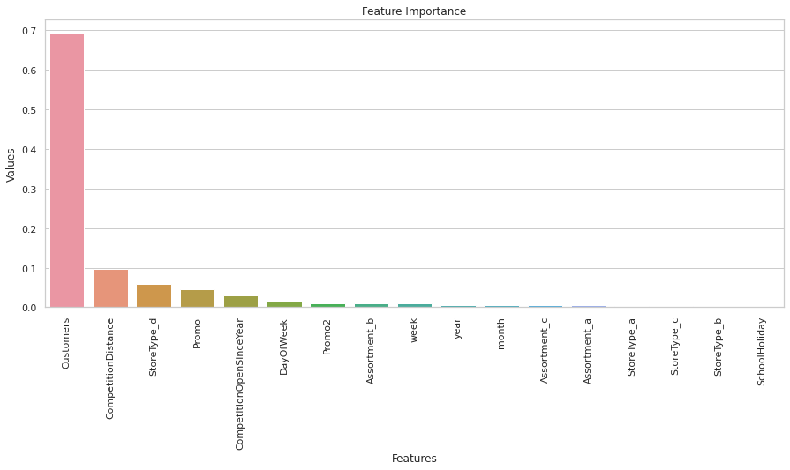
Feature Importance
After selecting our Random Forest Regression model we can see the importance of each features in our model prediction.

Slide 26
Challenges Faced
Handling and understanding large amount of data.(1017209 number of records and 18 number of fields )
Columns with improper data type and wrong values.
Combining, creating and removing columns.
Records containing more than 50% of nan values and replacing it with substitutes.
Removing and replacing outliers from dependent and independent variables.
Reducing skewness from the variables.
Feature selections for ML Model.
Converting columns with categorical variables to integer type and scaling numerical
variables for regression models.
Performing and choosing right kind of model.

Slide 27
Conclusions
Store model 'b' have least number of stores in Rossmann yet it performed well and made more sales than other store models so it is advisable to increase the number of 'b' store model.
Assortment level ‘Extra (1)' have the maximum number of stores in Rossmann yet it performed very
badly but at the same time ‘Basic' and 'Extended' assortment level with less number of store had preformed extra ordinarily so it would be advisable to increase these assortment level.
we can conclude that stores need more supply in between July to December stores should offer some discount from January to June to attract more customers.
Sales has been low on the initial days of the month as compared to the end days, it can be assumed that people used to shop for the next month at the end of the previous month. Those products can be mainly be of basic necessities of a person's daily life.

Slide 28
Conclusions
Average sales on weekdays was more as compared to weekends because promo's were provided to the customers during weekdays to increase the sales and not to weekends and reason might be that store use to remain close on Sundays.
Sales during November and December month was higher compared to other months and that can be due to festive season in western European countries.
School holidays also influenced the sales a lot as it can be observed that 17.8% of the sales gets affected
by the school holidays which also means that around 17% of the sales are oriented from the school students.
Performing various regression techniques, we can observe that XGboost Regression model have the better performance (with R2 : 0.9337) and we finally came to the conclusion that 'Random Forest Regression' model have even higher performance (with R2 :0.9948) among the other models, as Random Forest Regression can handle large datasets efficiently and it's algorithm provides a higher level of accuracy in predicting outcomes over any other regression algorithm.

Slide 29

THANK YOU

